Slide 1
ATM Simulator (Project) 6TH Semester
Submitted to : submitted by:
DR. Harkesh sehrawat sir Pratyush patil
(asst. professor) roll no : 25613
Department of comp. science EXAM ROLL NO : 4056313
Mdu , Rohtak

Slide 2
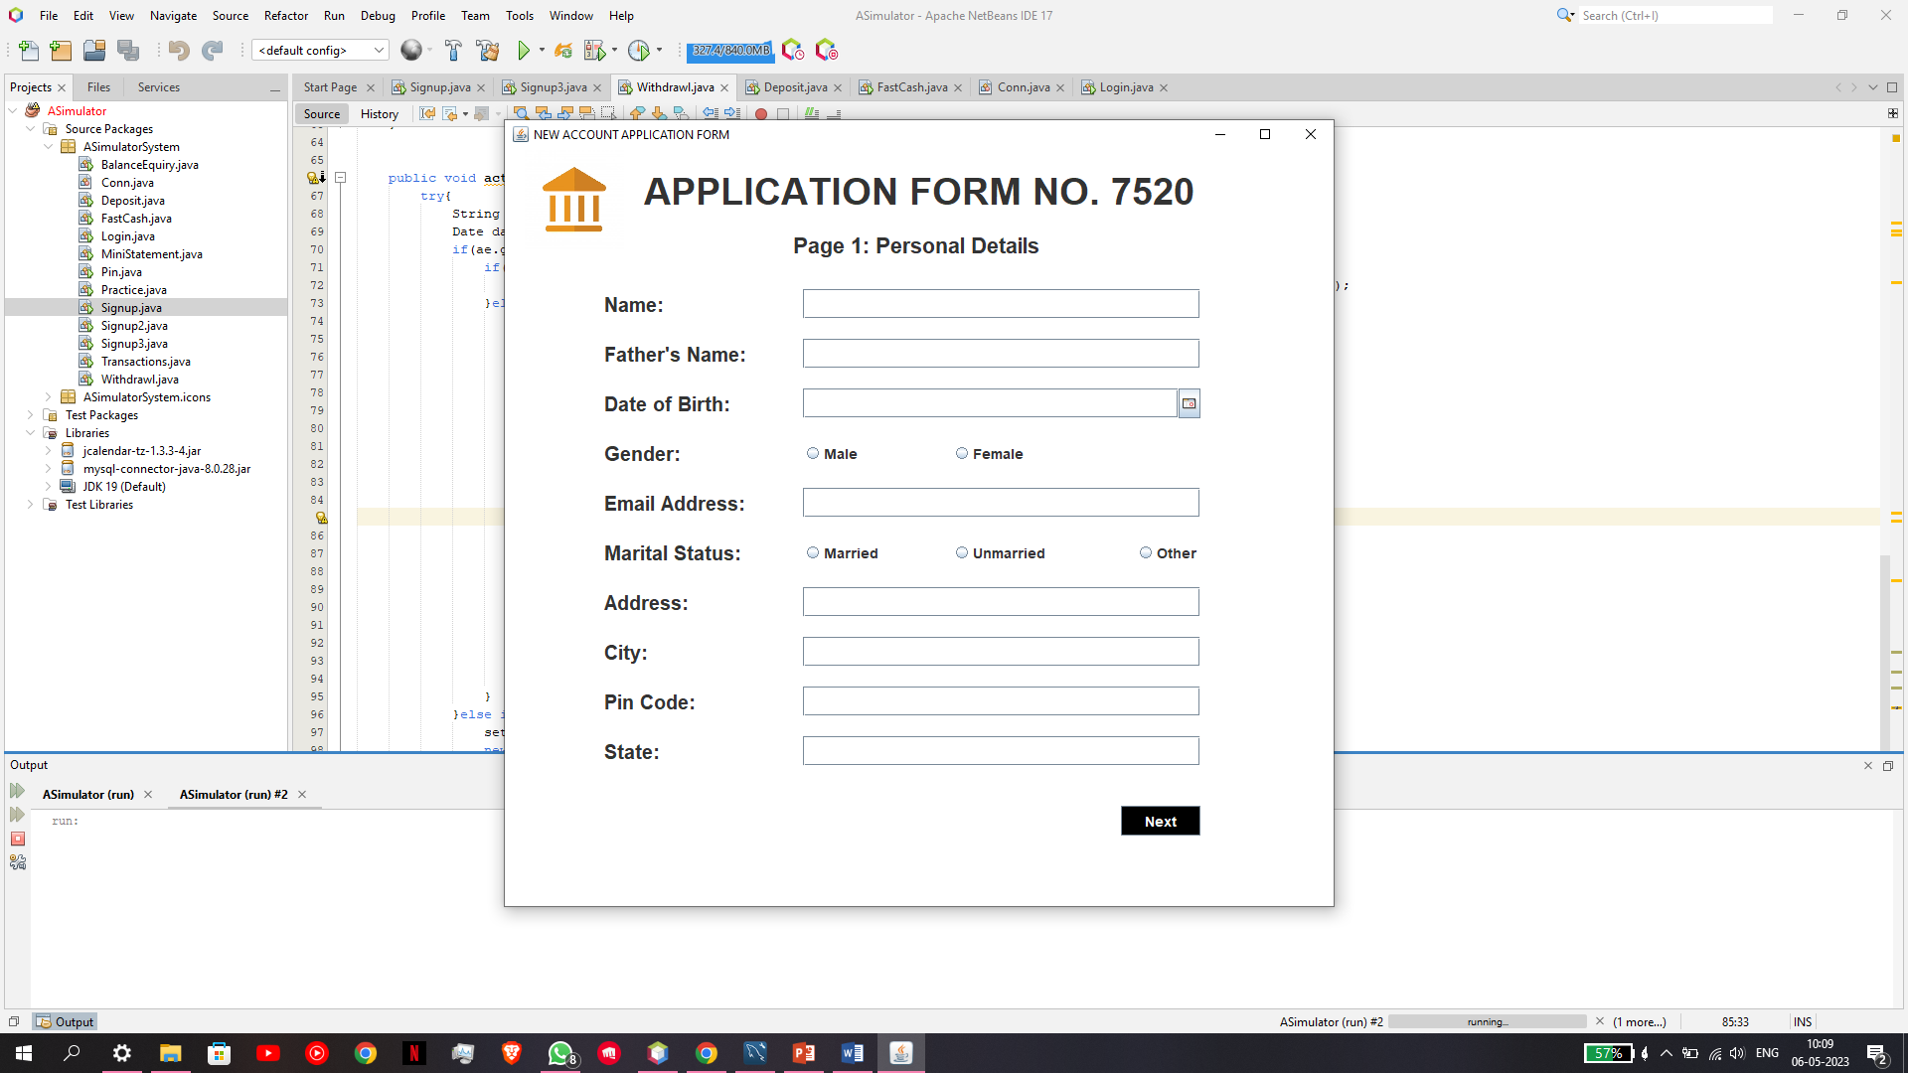
HOW TO CREATE A NEW ATM USER
SCREENSHOT 1
IF THERE IS A NEW USER WHO DOESN’T HOLD AN EXISTING ACCOUNT IN OUR DATABASE
THEN WE HAVE A SIGN UP WINDOW WHERE THE USER CAN ENTER THE FOLLOWING DETAILS THAT HAS BEEN ASKED HERE FOR REFERENCE CHECK THE SCREEENSHOT PROVIDED HERE .

Slide 3
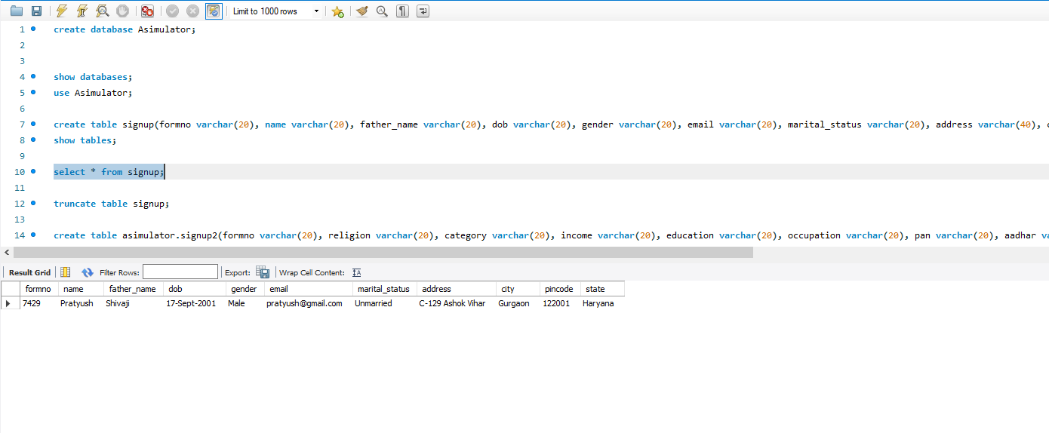
ENTRY OF NEW USER IN THE DATABASE
AFTER FILLING THESE DETAILS WE HAVE A UPDATED ROW IN OUR DATABSE WITH ALL THE NECESSARY DETAILS CHECK THE SECOND SCREEN SHOT PROVIDED HERE .

Slide 4
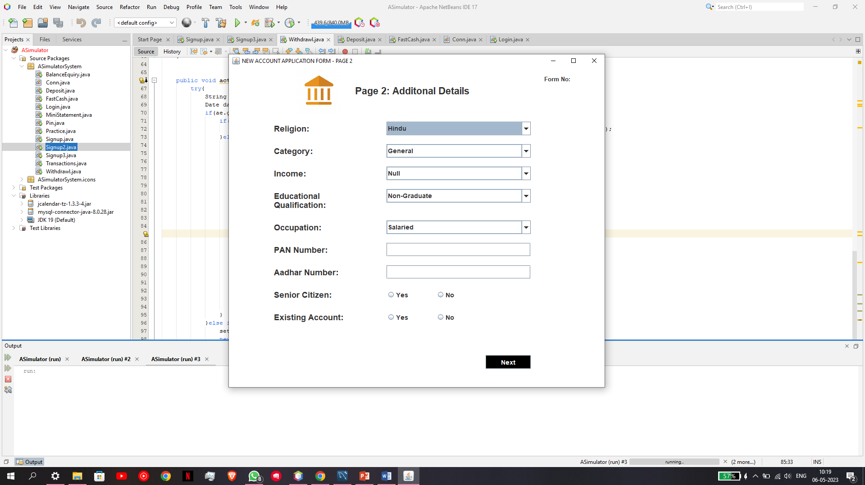
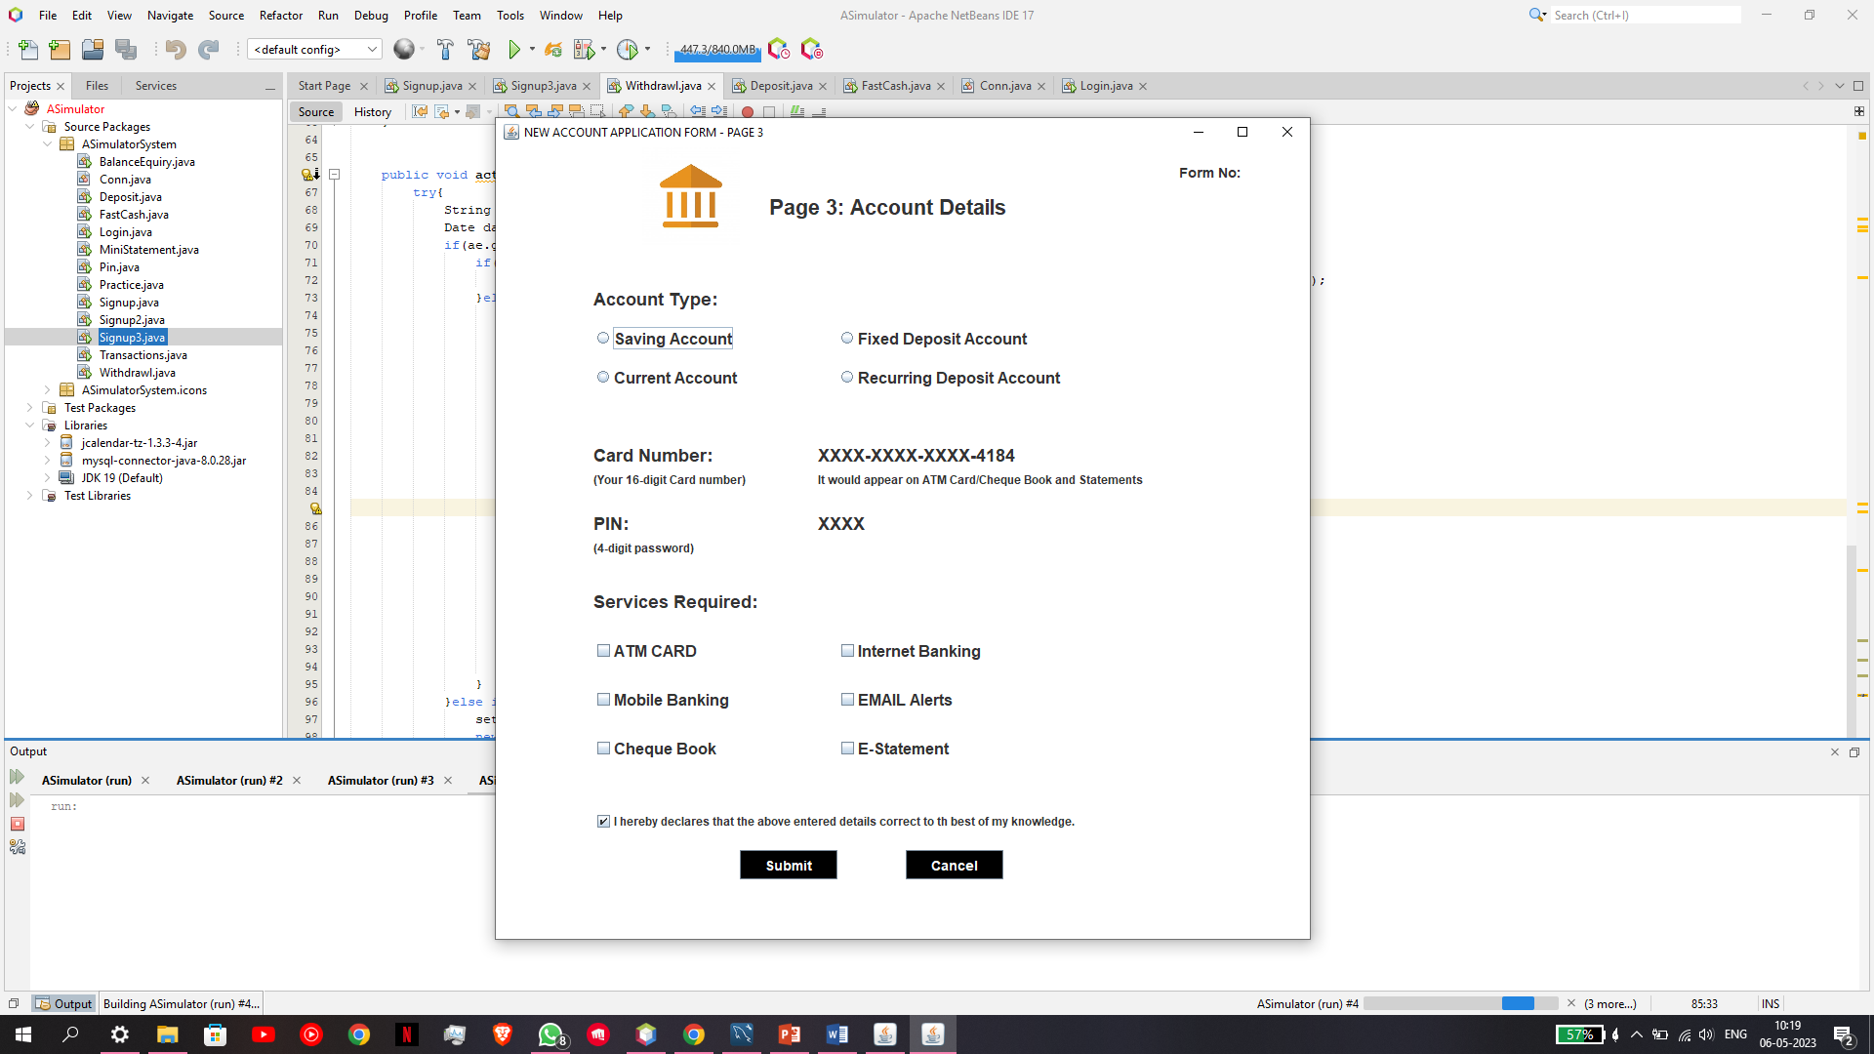
FEW MORE DETAILS REQUIRED TO CREATE NEW ACCOUNT
AS ABOVE IN BOTH THE SCREENSHOTS WE CAN SEE THAT IN THESE WINDOWS THEY ARE ASKING FOR FEW MORE DETAILS SO THAT INCASE WE EVER NEED THAT INFORMATION WE WILL HAVE IT ORGANISED .
AFTER FILLING THESE DETAILS WE HAVE BEEN PROVIDED WITH A RANDOM CARD NO AND A PIN NO GENERATED BY THE APPLICATION.

Slide 5
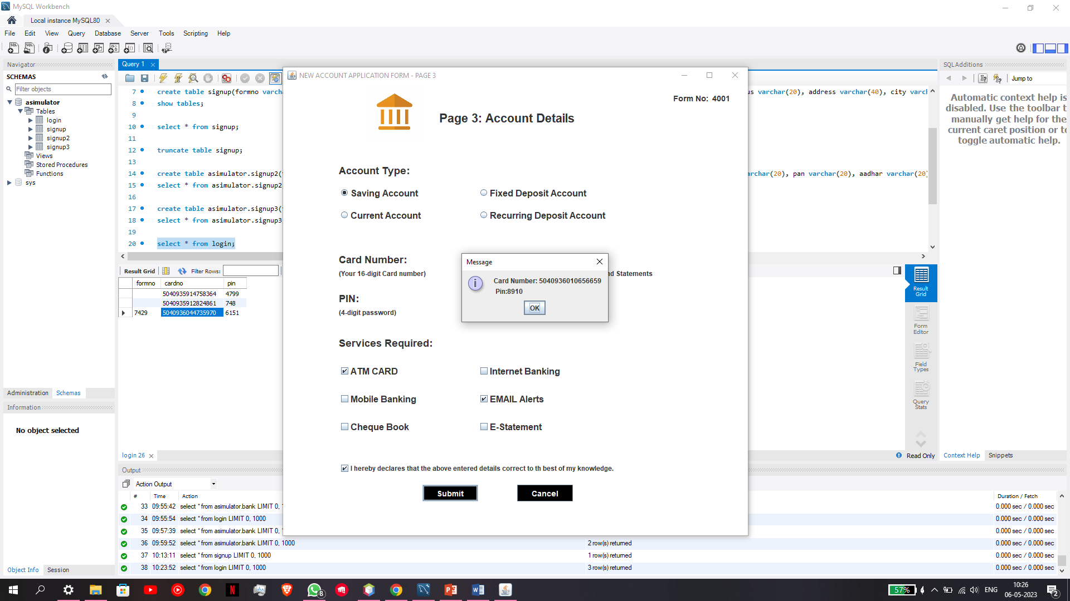
NEW CREDENTIALS THAT HAS BEEN PROVIDED TO USER BY THE APPLICATION
AFTER FILLING THESE DETAILS WE HAVE BEEN PROVIDED WITH A RANDOM CARD NO AND A PIN NO GENERATED BY THE APPLICATION.
FOR FURTHER DETAILS REFER TO THE SCREENSHOT PROVIDED HERE .

Slide 6
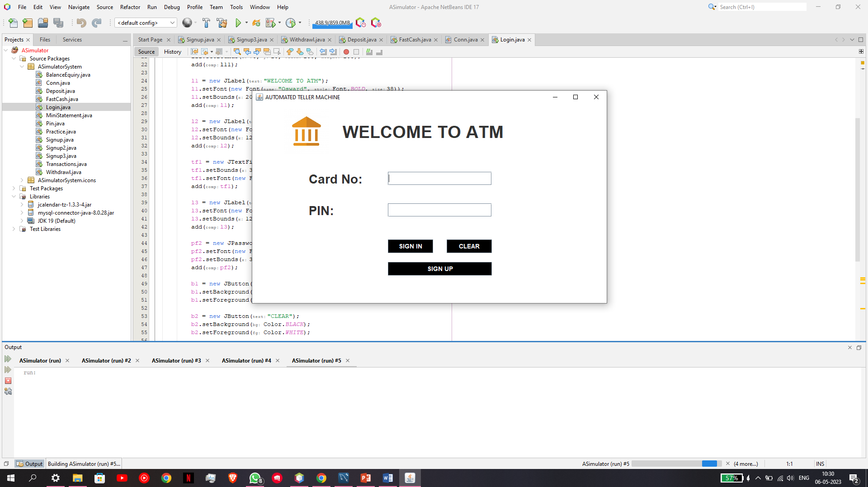
EXISTING USER LOGIN METHOD
IF THERE IS AN EXISTING USER THEN THEY CAN LOGIN BY PROVIDING THE DETAILS GIVEN TO THE USER AFTER ACCOUNT CREATION .
I.E CARD NO AND PIN NO
HERE IN THIS SCREENSHOT WE CAN SEE THAT THE LOGIN WINDOW ASKS FOR THE SAME INFORMATION .
AFTER ENTERING THE INFORMATION AN INTERFACE APPEARS WHERE THERE ARE MUTLIPLE FEATURES .

Slide 7
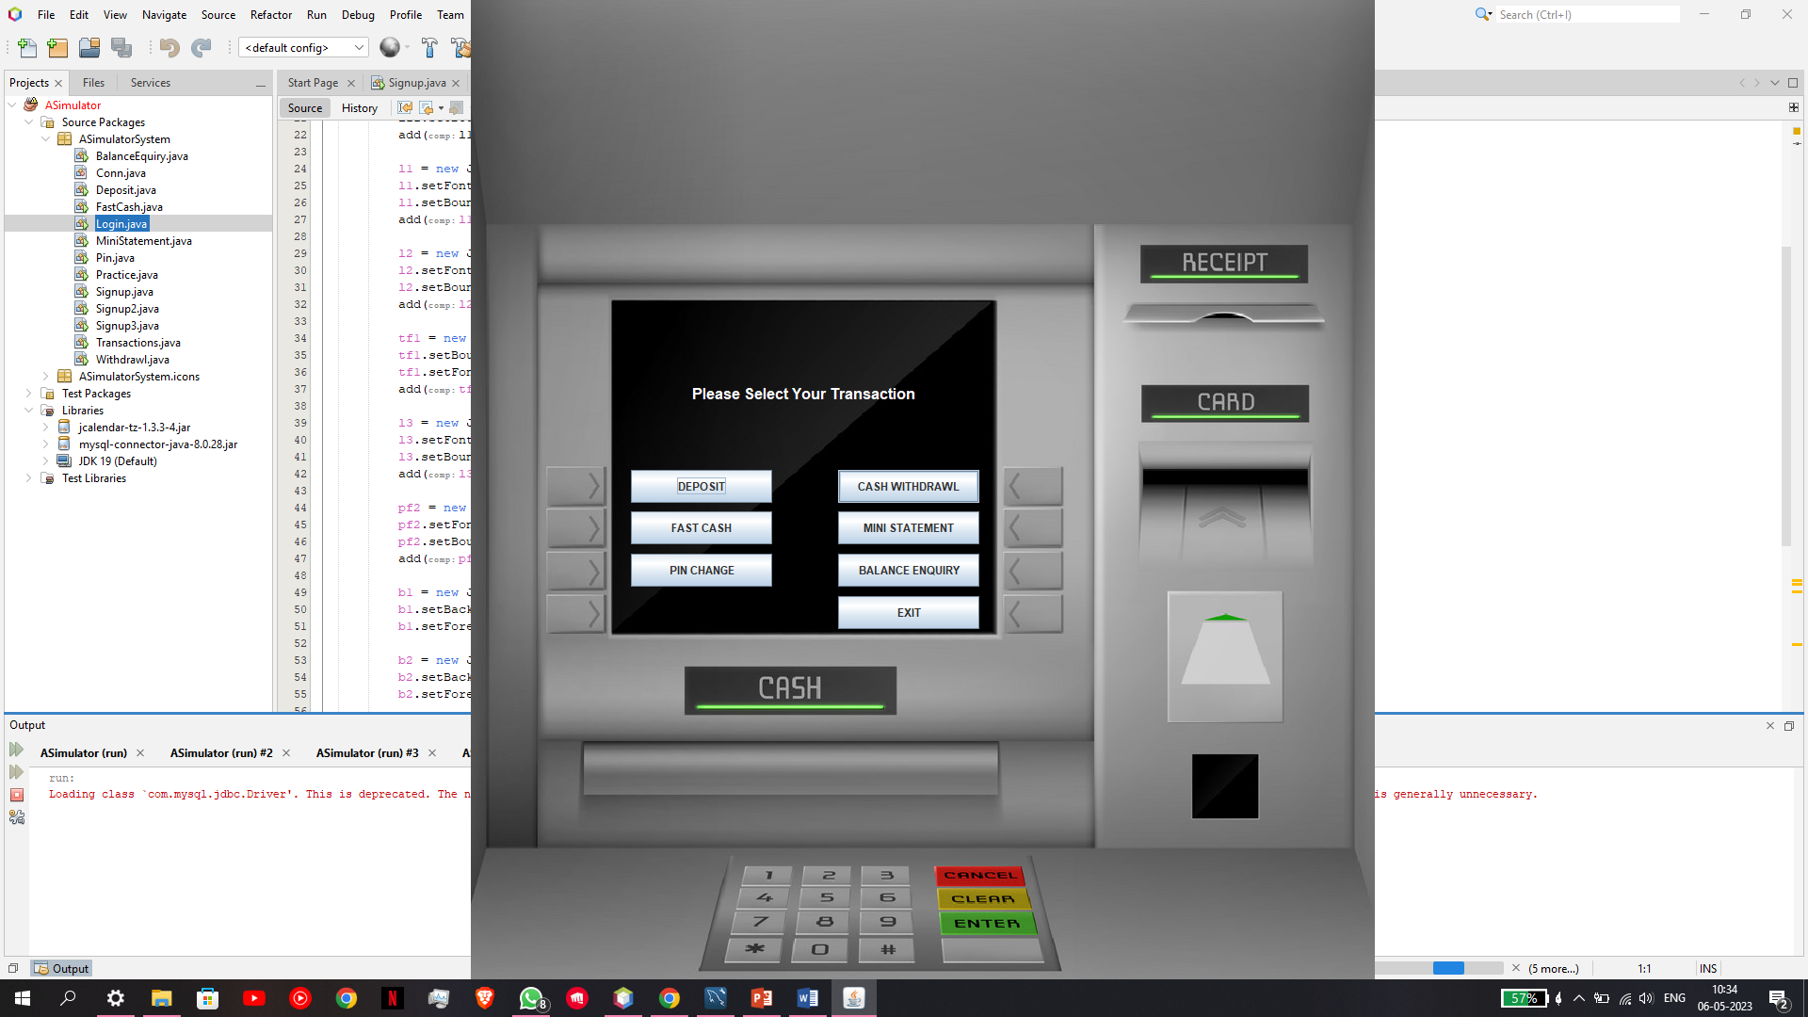
FEATURES PROVIDED BY THE APPLICATION
FEATURES PROVIDED BY THE ATM APPLICATION ARE MENTIONED BELOW :
DEPOSIT
FAST CASH
PIN CHANGE
CASH WITHDRAWL
MINI STATEMENT
BALANCE ENQUIRY
FOR FURTHER REFERENCE PLEASE REFER TO THE SCREENSHOT PROVIDED HERE.

Slide 8
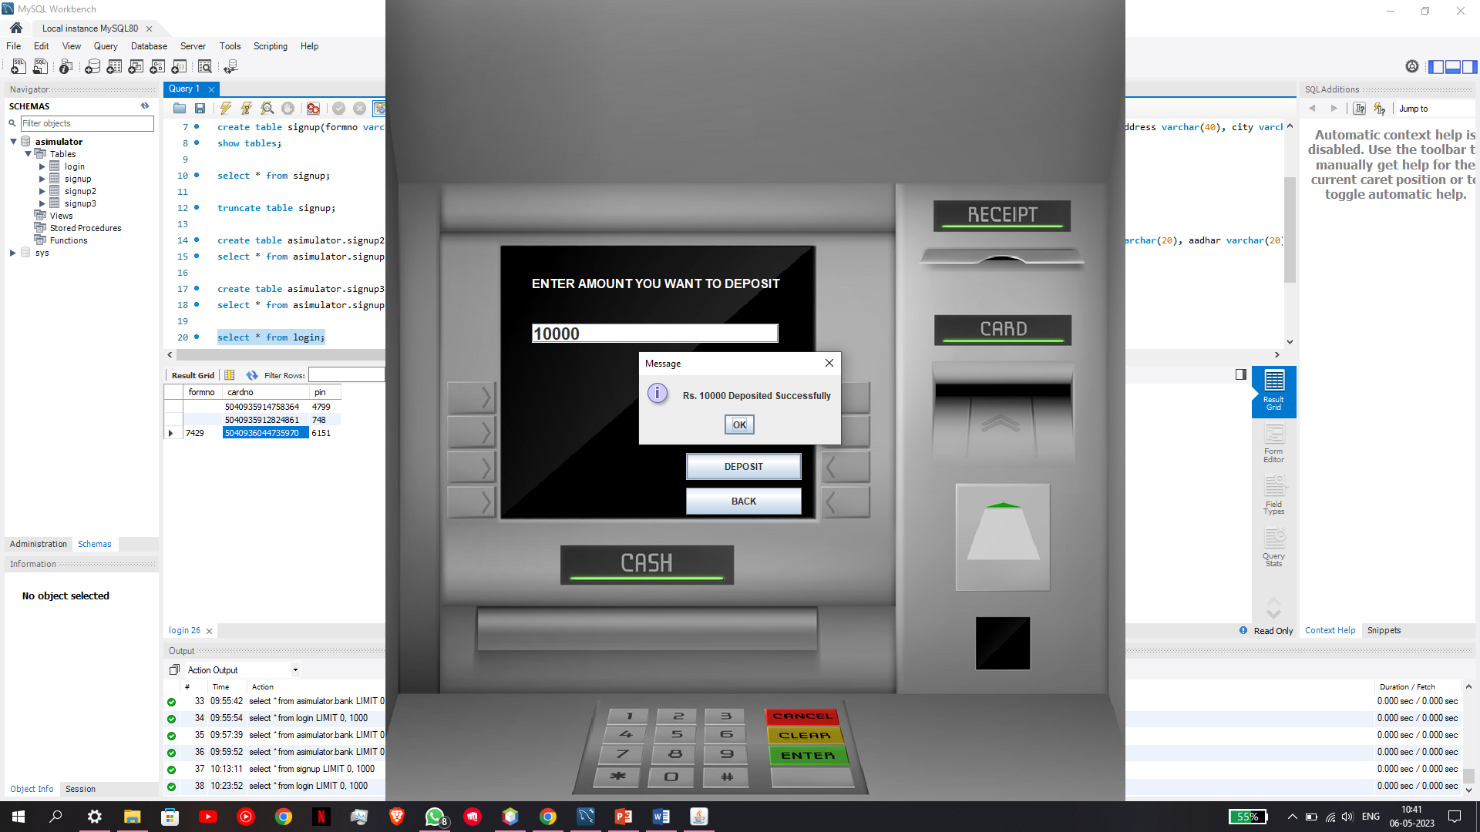
HOW TO DEPOSIT AMOUNT
AFTER THE ATM INTERFACE SHOWS UP CLICK ON THE FIRST OPTION I.E TO DEPOSIT MONEY.
IN THE SCREENSHOT PROVIDED HERE YOU CAN SEE THAT I ENTERED RS 10,000 TO DEPOSIT IN THE BANK ACCOUT.
AND YET IT SUCCESSFULLY DEPOSITED THE ENTERED AMOUNT IN THE BANK ACCOUNT.

Slide 9
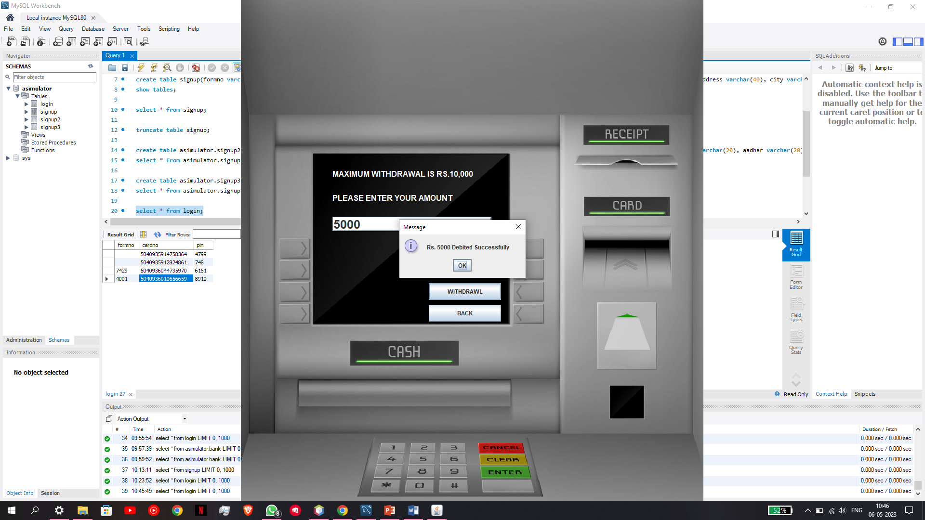
HOW TO WITHDRAW AMOUNT
AS YOU CAN SEE IN THE SCREENSHOT HERE I ENTERED THE AMOUNT 5000 AND AS WE HAVE DEPOSITED 10,000 EARLIER.
THEREFORE THE LEFTOVER BALANCE WOULD BE 5000.
TO CHECK THE TRANSACTION HISTORY THERE IS A FEATURE CALLED MINI STATEMENT THAT IS PROVIDED IN THE APPLICATION.

Slide 10
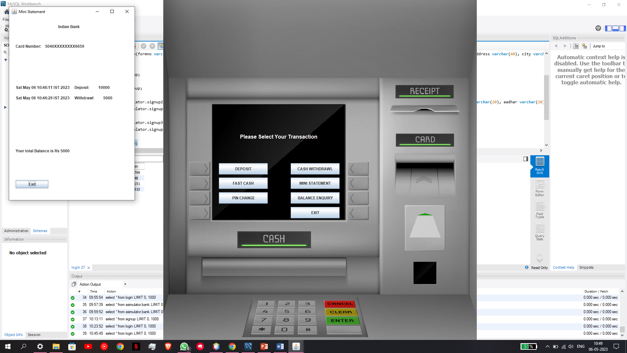
MINI STATEMENT OF THE BANK ACCOUNT
AS WE CAN SEE HERE IN THE MINI STATEMENT WINDOW.
WE HAVE BEEN PROVIDED WITH A HISTORY OF TRANSACTION THAT TOOK PLACE IN OUR ACCOUNT .
THIS IS A VERY IMPORTANT FEATURE SO THAT THE USER KNOWS WHERE HIS AMOUNT HAS BEEN SPENT OR CREDITED.

Slide 11
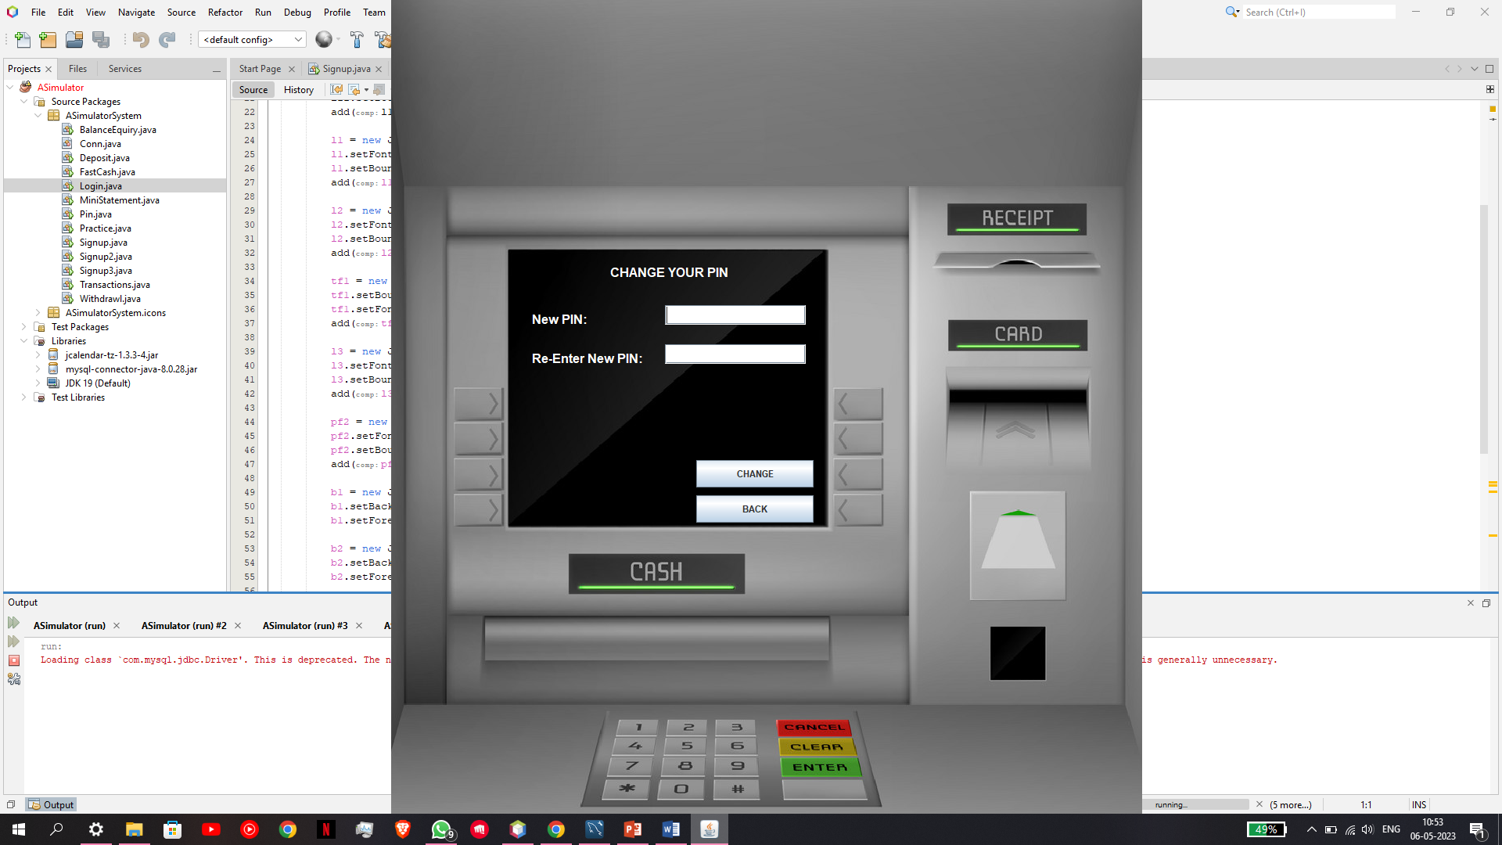
HOW TO CHANGE YOUR ACCOUNT PIN NO.
IF IN CASE THE USER FORGETS HIS/HER BANK ACCOUNT PIN NO .
THEN THEY CAN OPT FOR PIN RESET FEATURE WHERE THEY CAN ENTER A NEW STRONG PIN AND IT WILL BE UPDATED IN OUR DATABSE SYSTEM THAT THE PIN NO. OF FOLLOWING ACCOUNT HAS BEEN UPDATED BY THE USER.

Slide 12
THANK YOU
NAME - PRATYUSH PATIL
CLASS - CSE B
ROLL NO - 25613 (4056313)
SUBJECT – PROJECT (ATM SIMULATOR)

